Slide 1
Devoxx France 2016
sample presentation
Nicolas Martignole @nmartignole
Zouheir Cadi @zouheircadi
Antonio Goncalves @agoncal

Slide 2
Welcome to Devoxx France
This is a template created from Keynote and exported to Power Point
Format 16/9

Slide 3

We love picture
We try to keep the Devox France logo and the Tweet hashtag on all slides

Slide 4
Roadmap
This is a slide without background images.
You must load and install 2 Fonts on your system :
Montserrat : for titles
Open Sans : for body
Menlo : for code

Slide 5
Devoxx FR 2016 colors
main color, purple, #2a013b purple
secondary color, #b10142, dark pink
third color, smoke white #eeeeee white smoke
fourth color, dark purple #10001a dark purple

Slide 6
Show me shome code !
Try to keep a font size as big as possible. Remember also that too much code on one slide is useless. The audience reads this texte and does not listen to your presentation anymore. Try to split on different slides your presentation.

Slide 7
Step 1 : add to Redis sorted set
127.0.0.1:6363[2]> zadd hackers 1953 "Richard Stallman"
(integer) 1
127.0.0.1:6363[2]>
127.0.0.1:6363[2]> zadd hackers 1969 "Linus"
(integer) 1
127.0.0.1:6363[2]> zadd hackers 1912 "Alan turing"
(integer) 1

Slide 8
Step 2 : Show the list of Hackers
127.0.0.1:6363[2]> zadd hackers 1953 "Richard Stallman"
(integer) 1
127.0.0.1:6363[2]>
127.0.0.1:6363[2]> zadd hackers 1969 "Linus"
(integer) 1
127.0.0.1:6363[2]> zadd hackers 1912 "Alan turing"
(integer) 1
127.0.0.1:6363[2]> zrange hackers 0 -1
1) "Alan turing"
2) "Richard Stallman"
3) "Linus"

Slide 9
Step 3 : Show the list with score
127.0.0.1:6363[2]> zadd hackers 1953 "Richard Stallman"
(integer) 1
127.0.0.1:6363[2]>
127.0.0.1:6363[2]> zadd hackers 1969 "Linus"
(integer) 1
127.0.0.1:6363[2]> zadd hackers 1912 "Alan turing"
(integer) 1
127.0.0.1:6363[2]> zrange hackers 0 -1
1) "Alan turing"
2) "Richard Stallman"
3) "Linus"
127.0.0.1:6363[2]> zrange hackers 0 -1 withscores
1) "Alan turing"
2) "1912"
3) "Richard Stallman"
4) "1953"
5) "Linus"
6) "1969"

Slide 10
Step 4 : Last step with transparent code
127.0.0.1:6363[2]> zadd hackers 1953 "Richard Stallman"
(integer) 1
127.0.0.1:6363[2]>
127.0.0.1:6363[2]> zadd hackers 1969 "Linus"
(integer) 1
127.0.0.1:6363[2]> zadd hackers 1912 "Alan turing"
(integer) 1
127.0.0.1:6363[2]> zrange hackers 0 -1
1) "Alan turing"
2) "Richard Stallman"
3) "Linus"
127.0.0.1:6363[2]> zrange hackers 0 -1 withscores
1) "Alan turing"
2) "1912"
3) "Richard Stallman"
4) "1953"
5) "Linus"
6) "1969"
127.0.0.1:6363[2]> zrangebyscore hackers 1910 1940
1) "Alan turing"

Slide 11
Live Demo

Slide 12
Merci / Thanks you

Slide 13

This is not me
Devoxx France 2016 figures and numbers :188 speakers with a badge, 36 exhibitors

Slide 14
Less code is less bug

Slide 15
Why less slides is better than more slides
Devoxx France 2016 runs on 3 days
Audience loves live coding and demo
Too much bullet points is super boring
More text : less concentration from the audience that will just read your slides
So this is exactly what you should not do

Slide 16
Pourquoi peu de diapositives c’est mieux
Devoxx France 2016 se déroule sur 3 jours
Le public préfère les démonstrations et l’écriture de code en direct
Trop de points avec des puces c’est ennuyant
Plus il y a de texte à lire sur vos diapos, moins l’audience vous écoute
Si vos slides peuvent vous remplacer, alors vous ne servez à rien comme orateur
Imaginez que votre ensemble de diapos ne doivent pas pouvoir vivre sans vous, sans votre présentation et votre contenu
Merci donc de ne PAS faire comme ce slide à mourir

Slide 17

Toujours plus d'image
Les diagrammes dynamiques c’est vraiment top

Slide 18
Redis Set
Speakers
English
French
Web
Selected
Java

Slide 19
Redis Set : French Selected Speakers
French
Speakers
English
Selected
Web
Java

Slide 20
Screen capture
https://cfp.devoxx.fr

Slide 21
Here are just a few photos from Devoxx France 2015 so that you get a better idea of what you’re about to live
Voici quelques photos de Devoxx France 2016 afin de vous donner une idée de ce que vous vous apprêtez à vivre…

Slide 22
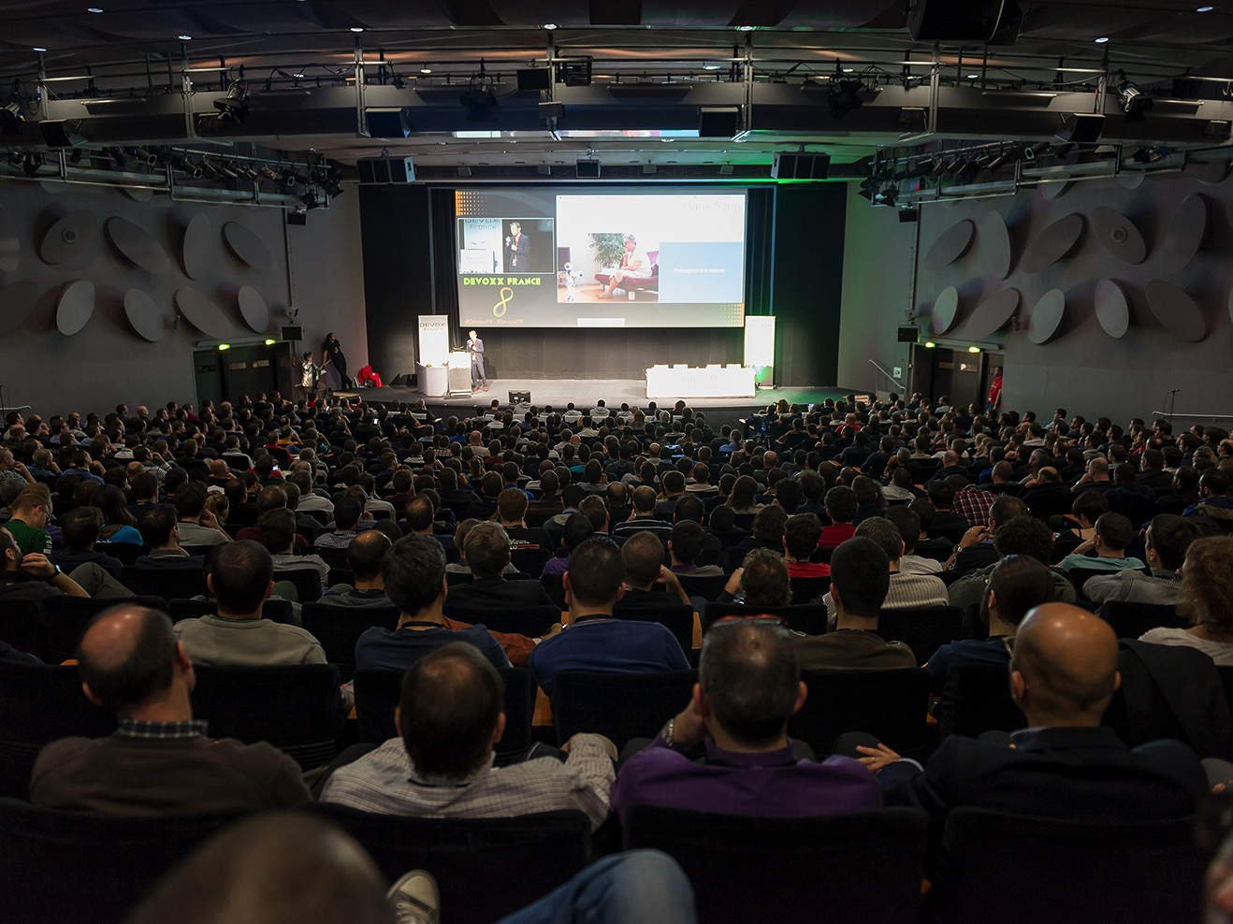

Slide 23
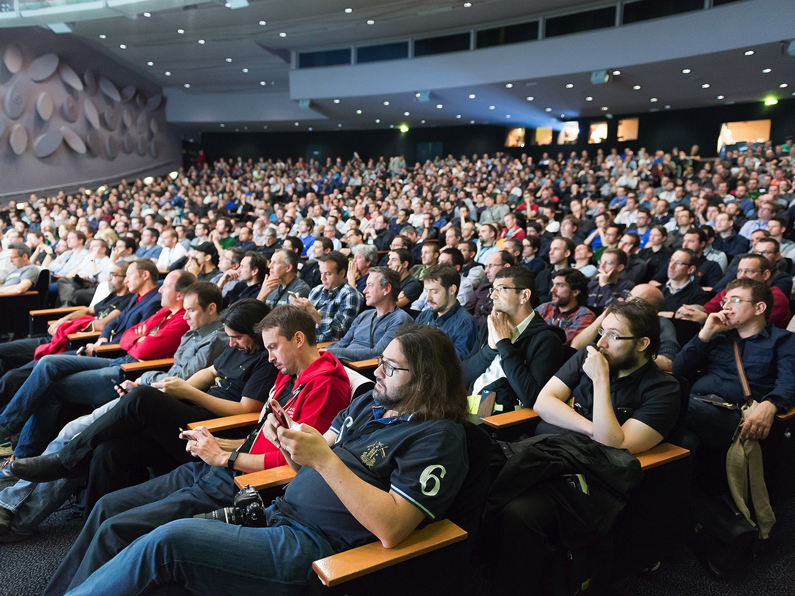

Slide 24
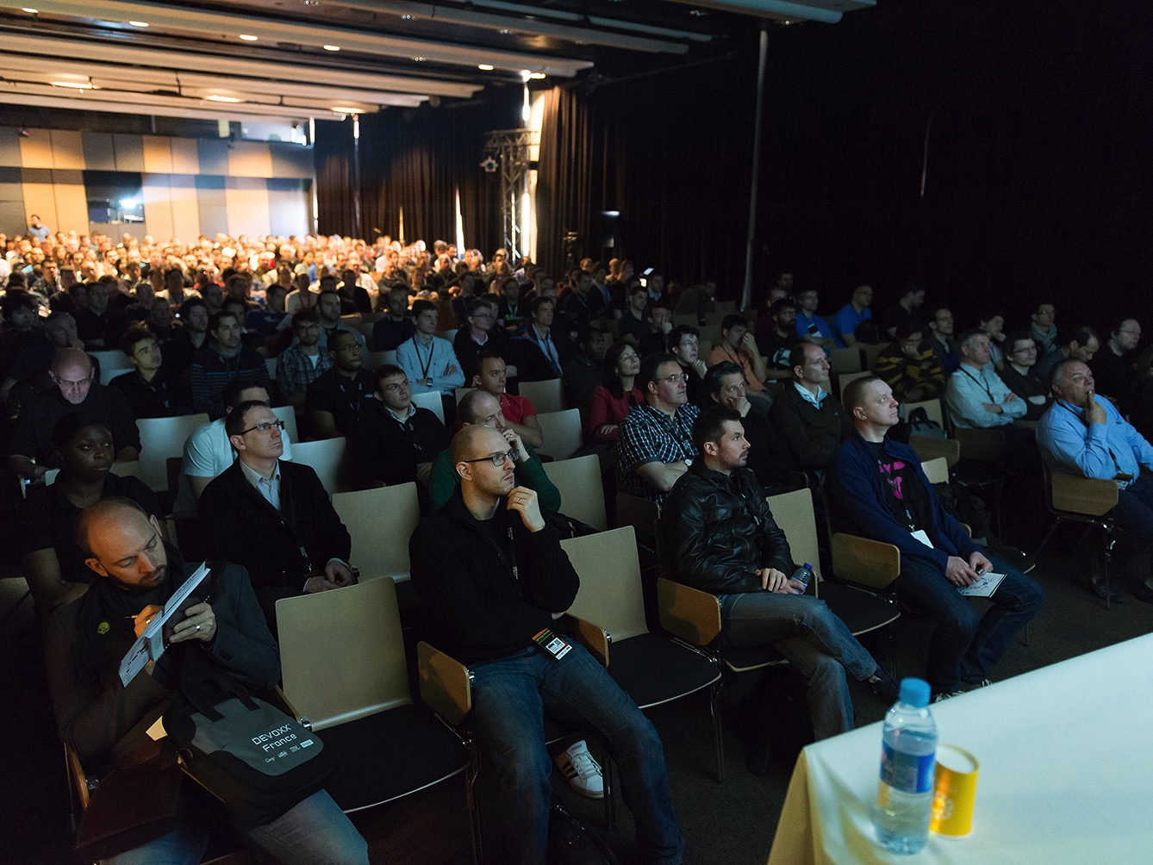

Slide 25
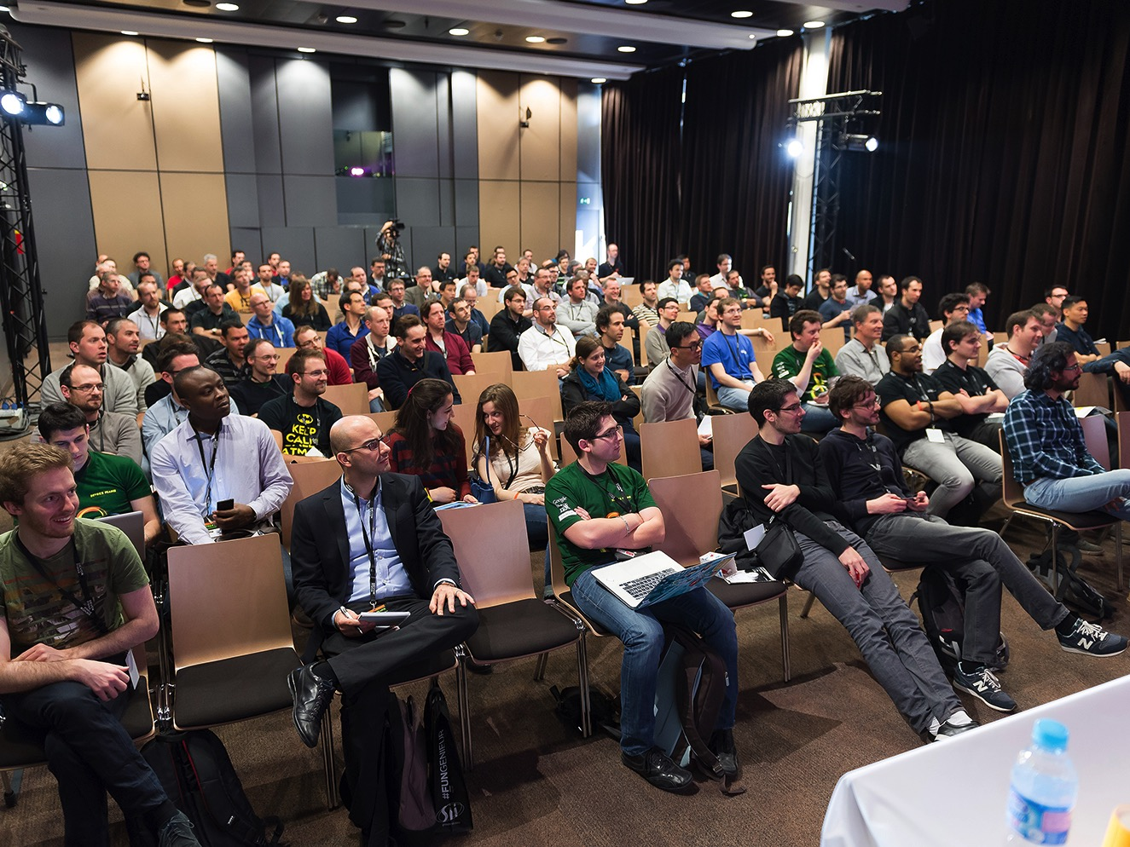

Slide 26
Thanks
Contribute and propose other templates on
https://bitbucket.org/nicolas_martignole/devoxxfr_2016_templates/overview

